Slide 1


PYTHON
Lecture 11

Slide 2

Today’s Agenda
Operators In Python
Relational Operators
Relational Operators With Strings
Chaining Of Relational Operators
Special Behavior Of == and !=

Slide 3
Relational Operators In Python
Relational operators are used to compare values.
They either return True or False according to the condition.
These operators are:
Operator | Meaning
> | Greater Than
< | Less Than
>= | Greater Than Equal To
<= | Less Than Equal To
== | Equal To
!= | Not Equal To

Slide 4
The 6 Basic Relational Operators
myrelop.py
a=10
b=4
print("a=",a,"b=",b)
print("a > b",a>b)
print("a < b",a<b)
print("a==b",a==b)
print("a!=b",a!=b)
print("a>=b",a>=b)
print("a<=b",a<=b)

Slide 5
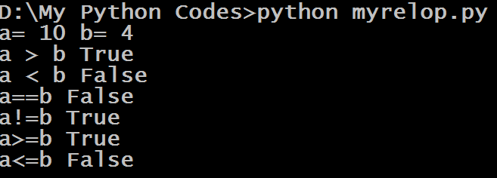
The 6 Basic Relational Operators
The Output:

Slide 6
Relational Operators With Strings
Relational Operators can also work with strings .
When applied on string operands , they compare the unicode of corresponding characters and return True or False based on that comparison.
As discussed previously , this type of comparison is called lexicographical comparsion

Slide 7
Relational Operators With Strings
myrelop2.py
a="Ramesh"
b="Rajesh"
print("a=",a,"b=",b)
print("a > b",a>b)
print("a < b",a<b)
print("a==b",a==b)
print("a!=b",a!=b)
print("a>=b",a>=b)
print("a<=b",a<=b)

Slide 8
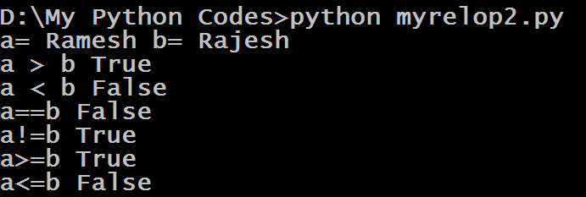
Relational Operators With Strings
The Output:

Slide 9
Relational Operators With Strings
If we want to check the UNICODE value for a particular letter , then we can call the function ord().
It is a built in function which accepts only one character as argument and it returns the UNICODE number of the argument passed
Example:
ord(‘A’)
65
ord(‘m’)
109
ord(‘j’)
106

Slide 10
Relational Operators With Strings
myrelop4.py
a= "BHOPAL"
b= "bhopal"
print("a=",a,"b=",b)
print("a > b",a>b)
print("a < b",a<b)
print("a==b",a==b)
print("a!=b",a!=b)
print("a>=b",a>=b)
print("a<=b",a<=b)

Slide 11
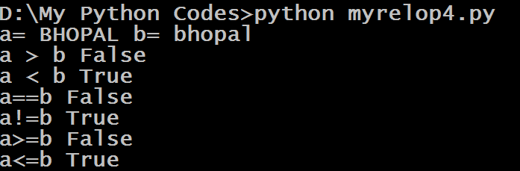
Relational Operators With Strings
The Output:

Slide 12
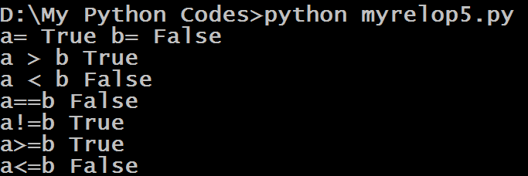
Will This Code Run ?
a=True
b=False
print("a=",a,"b=",b)
print("a > b",a>b)
print("a < b",a<b)
print("a==b",a==b)
print("a!=b",a!=b)
print("a>=b",a>=b)
print("a<=b",a<=b)
Yes , the code will successfully
Run because True is 1 and False is 0
Output:

Slide 13
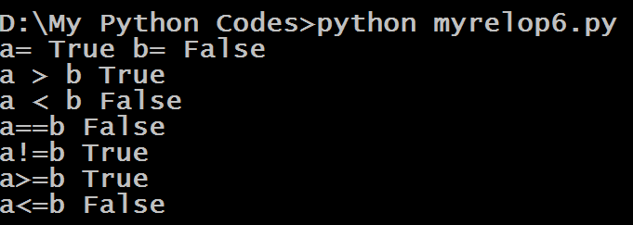
What about this code?
a=‘True’
b=‘False’
print("a=",a,"b=",b)
print("a > b",a>b)
print("a < b",a<b)
print("a==b",a==b)
print("a!=b",a!=b)
print("a>=b",a>=b)
print("a<=b",a<=b)
Yes , this code will also successfully
Run but ‘True’ and ‘False’ will be handled as strings
Output:

Slide 14
Special Behavior Of Relational Operators
Python allows us to chain multiple relational operators in one single statement.
For example the expression 1<2<3 is perfectly valid in Python
However when Python evaluates the expression , it returns True if all individual conditions are true , otherwise it returns False

Slide 15
Cascading Of Relational Operators
Example:
print(5<6>7)
Output:
False
Example:
print(7>6>5)
Output:
True

Slide 16
Cascading Of Relational Operators
Example:
print(5<6<7)
Output:
True
Example:
print(5>6>7)
Output:
False

Slide 17
Special Behavior Of == And !=
== compares it’s operands for equality and if they are of compatible types and have same value then it returns True otherwise it returns False
Similarly != compares it’s operands for inequality and if they are of incompatible types or have different value then it returns True otherwise it returns False

Slide 18
Special Behavior Of == And !=
Example:
print(10==20)
Output:
False
Example:
print(10==10)
Output:
True

Slide 19
Special Behavior Of == And !=
Example:
print(10==True)
Output:
False
Example:
print(10==“10”)
Output:
False

Slide 20
Special Behavior Of == And !=
Example:
print(“A”==“A”)
Output:
True
Example:
print(1==True)
Output:
True

Slide 21
Special Behavior Of == And !=
Example:
print(“A”==65)
Output:
False
Example:
print(“A”==“65”)
Output:
False

Slide 22
Special Behavior Of == And !=
Example:
print(15==15.01)
Output:
False
Example:
print(15==15.0)
Output:
True

Slide 23
Special Behavior Of == And !=
Example:
print(0 != False)
Output:
False
Example:
print(15!=“15”)
Output:
True

Slide 24
Special Behavior Of == And !=
Example:
print(False != 0.0)
Output:
False
Example:
print(False!=True)
Output:
True

Slide 25
Special Behavior Of == And !=
Example:
print(2+5j!= 2)
Output:
True
Example:
print(2+5j==2+5j)
Output:
True

